Slide 1
Sorta Bus Rider Advisory Council

Slide 2
Transforming how decisions are made, together
We believe that living an issue every day makes you an expert, and that leaders make better decisions when they can listen to and learn from that expertise.
We connect anchor institutions, government agencies, and innovative leaders with the everyday experts whose insights they need.

Slide 3
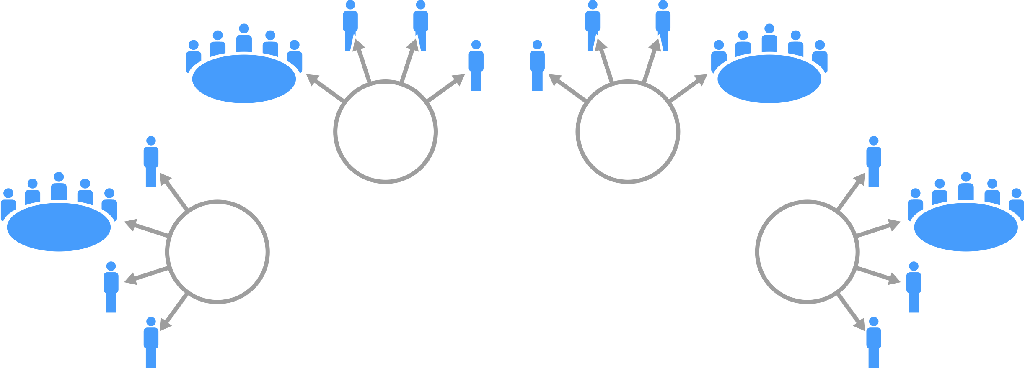
Cohear’s Organizing Model
SORTA Bus Rider Advisory Council | 2020
We rely on personal networks and relationships to help invite people to the table who might not otherwise be empowered to engage.
Cohear

Slide 4
People who rely on the bus system every day, or whose lives would be improved if they could rely on it, will have creative and critical ideas for improving how transit works.
Why a Bus Rider Council?
SORTA Bus Rider Advisory Council | 2020

Slide 5
05
Focus group style conversations
with current and potential bus riders
How We formed the Advisory Council
SORTA Bus Rider Advisory Council | 2020
10+
“Deep-dive” Qualitative Interviews
04
Rider Advisory Council Meetings
Cohear

Slide 6
Who we engaged
- PARTICIPANT DEMOGRAPHICS -
never (but are interested
7%
non-binary
<1%
seniors
4
White
47%
Race
African-
American
53%
Riders
everyday
47%
Gender
women
60%
Demographics
Millennials/ gen x
22
occasional
28%
men
30%
UC students
6

Slide 7
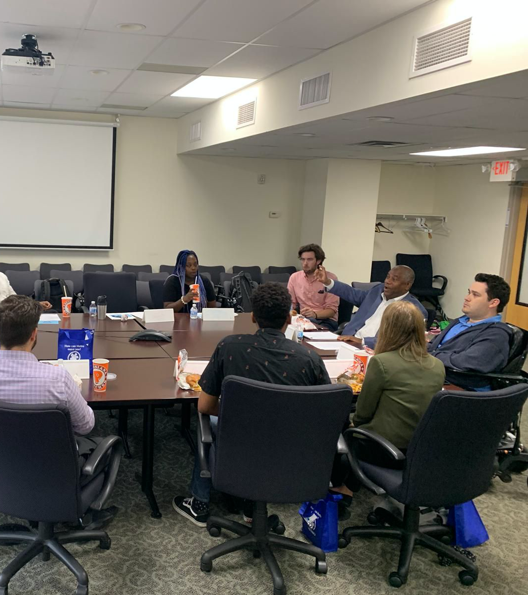
The Bus Rider Advisory Council
Gwen
Kalen
Jennifer
Neil
Le
Jon
Ellen
Danielle
Giovanni
Lonnie
Sheri
Andrea
SORTA Bus Rider Advisory Council | 2020
Cohear

Slide 8
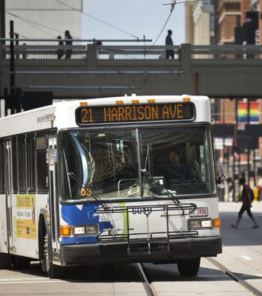
Example of bus rider-led change so far:
1
Revamping the Fare Deal program with an additional service location and extended service hours to make it easier to access for seniors and people with disabilities.
Updating bus operator training curriculums to include more de-escalation and cultural competency training.
Encouraging rider courtesy through a new series of fun and quirky signs.
New strategies to engage riders, and the development of a University of Cincinnati Student Task force.
SORTA Bus Rider Advisory Council | 2020
2
3
4
Cohear

Slide 9
1
Partner with event sites like EventBrite to highlight the bus routes that can take people to each event.
Collaborate with local artists who are looking to grow their following by inviting them to perform at bus stops or showcasing their artwork.
Recruit and train a team of “Metro ambassadors” at colleges and high schools to teach and encourage peers to ride the bus.
Provide incentives for bus riders to share their ridership with their friends by providing cash rewards for each new recommended rider or for reaching ridership milestones.
2
A few more innovative Ideas
SORTA Bus Rider Advisory Council | 2020
3
4

Slide 10
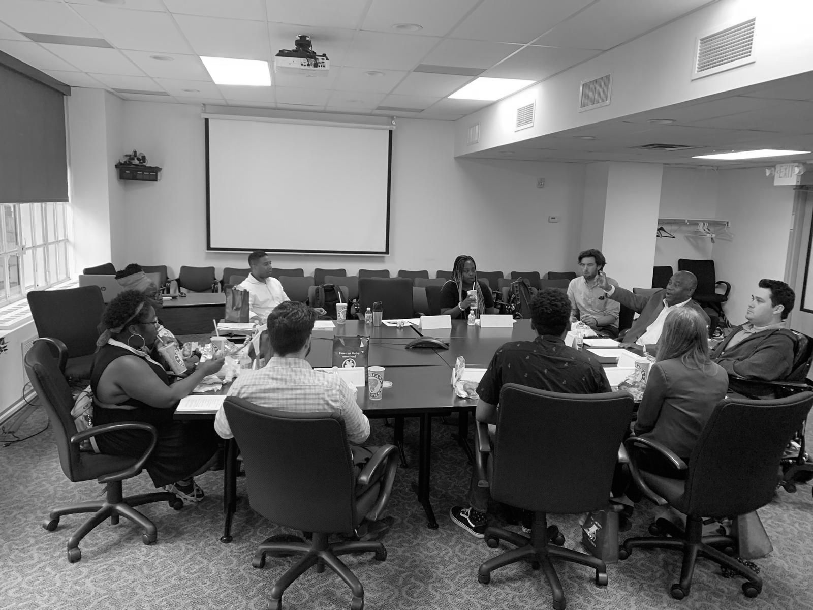
Questions?

Slide 11
Every transit authority should have a bus rider advisory council!
We’d love to meet and talk about potential partnership opportunities to deepen rider engagement, trust, and insight.
dani@wecohear.com

