Slide 1
Celebrating 100 years as a family founded business.
Family owned, and family run.

Slide 2
Designed for possibilities.
Made for people
World leading manufacturer of slip-resistant safety floors
Satisfying transportation industry needs for decades
Lightweight, hard wearing, low maintenance, and wide range of choices
Family owned and run since 1919
Committed to serve your needs
Notes:
Altro is a world leading manufacturer of slip resistant safety floors for transportation vehicles. Being the inventors of safety floors, Altro’s transport floors have been satisfying the diverse needs of the transportation industry for decades in both bus and rail applications. Our flooring products are lightweight, hard wearing, require low maintenance, and are available in a wide range of inviting designs. Family owned and run since 1919, we are committed to providing our customers with innovative products to serve their needs.

Slide 3
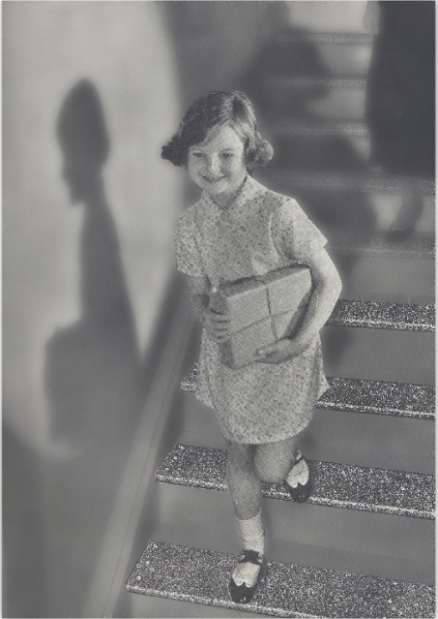
World Leader in Safety Flooring
We invented safety flooring in 1947
Our first sale in the US was NY Subway 1969
Today, we are available at every OEM world wide

Slide 4
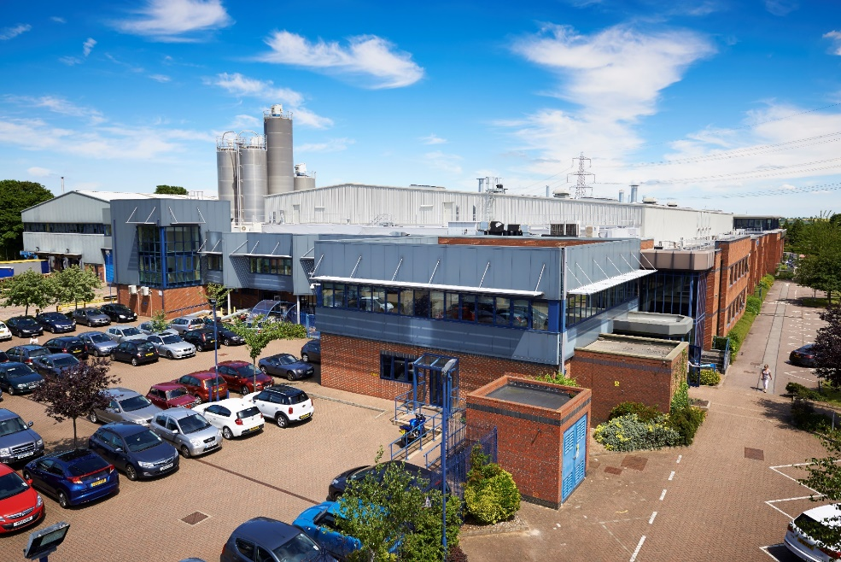
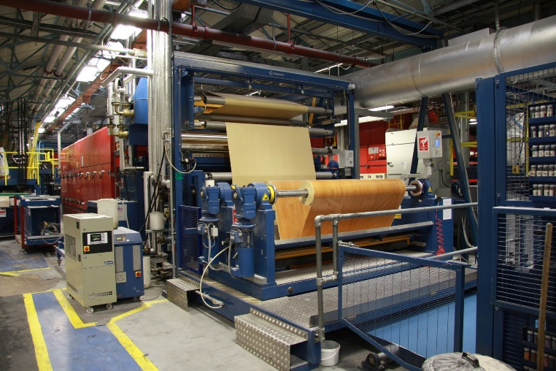
Altro HQ and Manufacturing plant - Letchworth UK
Altro’s focus is solely on safety floor manufacturing

Slide 5
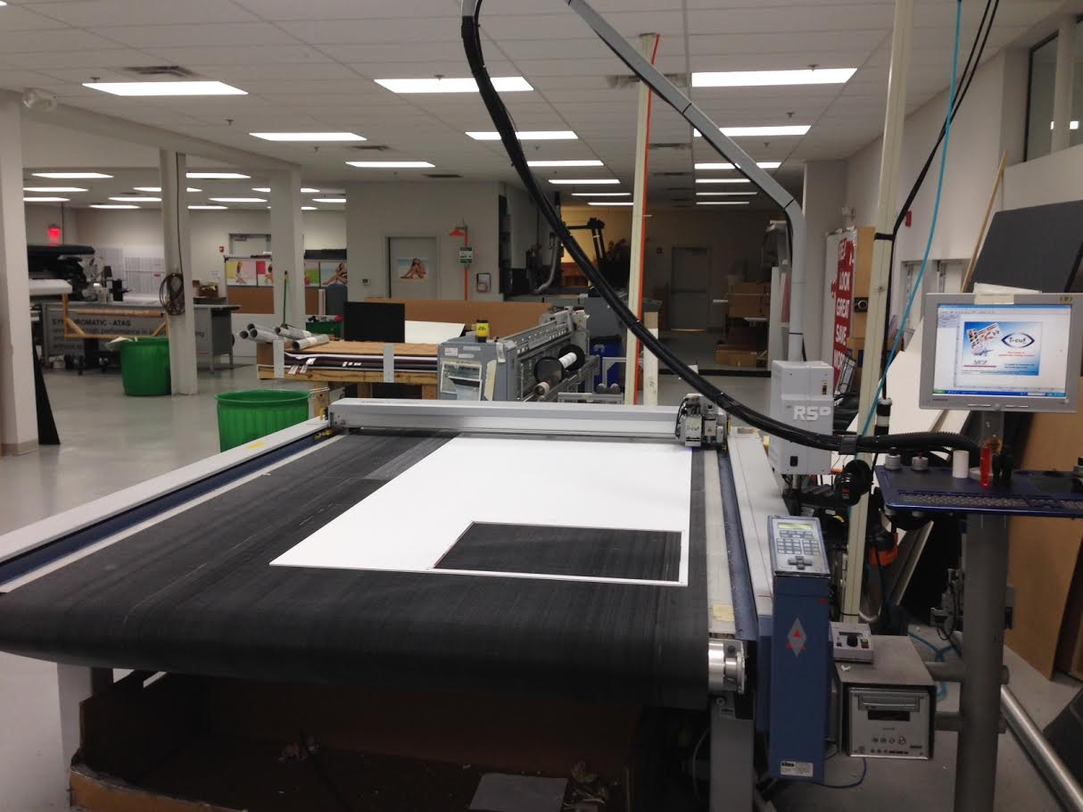
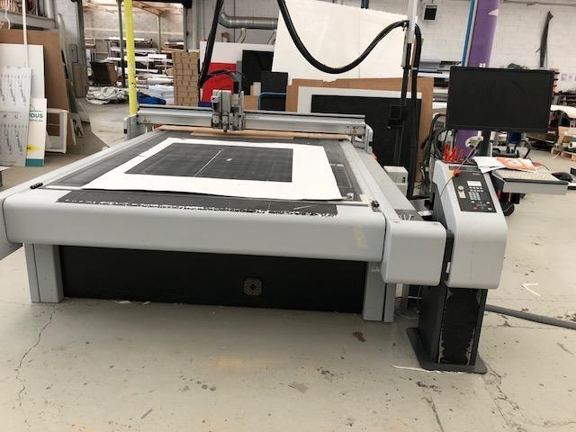
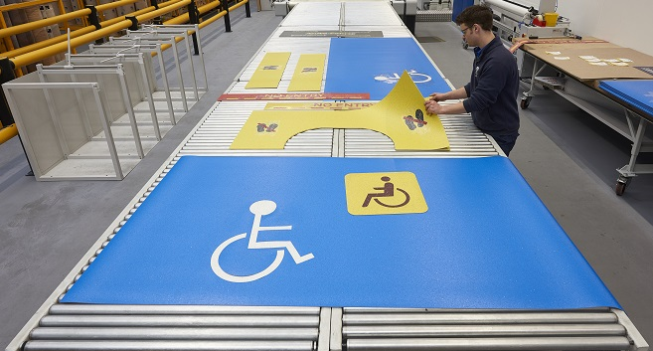
USA fabrication and service center - Santa Fe Springs, CA

Slide 6
How to Mitigate Risk
Safety flooring is imperative for reducing injures occurring on transit vehicles
The smallest amount of water between the heel and ground allows slips to occur
Safety floors minimize the risk
Altro manufactures to the highest global standards

Slide 7
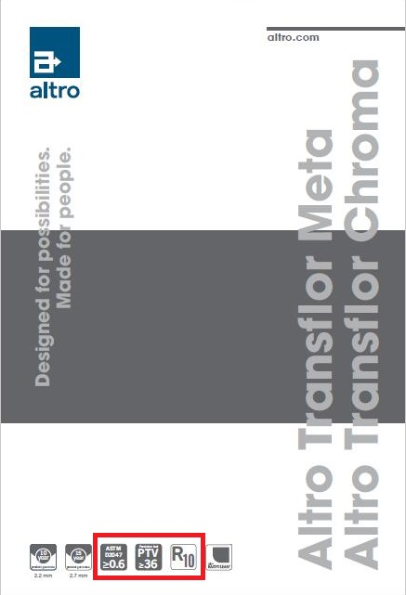
Altro exceeds all Global standards
Slip resistance can be measured by three methods
Local American standards ASTM D2047
Global Pendulum test
European standards
Ensure your floor meets all 3 standards

Slide 8
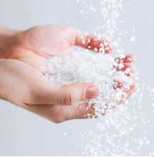
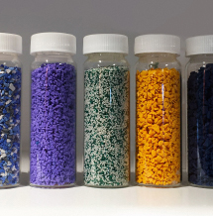
What is Altro Safety Flooring?
Unique patented construction of flexible, high-grade vinyl with slip-resistant aggregates embedded throughout wear layer
Vinyl
More durable than many other flooring materials
Thinner and lighter
Naturally impervious to water
Aggregates
Aluminum Trioxide, silicon carbide, and colored quartz - some of the hardest materials on Earth
A true slip-resistant, durable surface that will last for the life of the floor
Notes:
Altro floor coverings are a slip-resistant vinyl safety flooring. Altro’s unique patented construction of flexible, high-grade vinyl with slip-resistant aggregates embedded throughout the wear layer of the safety floor, ensures a durable surface that remains slip-resistant for the life of the floor. (Aluminum Trioxide – source of Altro’s name – and Silicon Carbide blended into the wear layer for exceptional sustained slip resistance, and Quartz for superior wear and scuff resistance)
Pound for pound, vinyl is more durable than many other flooring materials. This allows vinyl flooring to be thinner and lighter while still offering impressive durability. Combined with its natural imperviousness to water, vinyl makes an ideal flooring material especially for transit buses where passengers may track in snow or rain onto the bus.
Altro flooring incorporates aggregates of aluminum oxide, silicon carbide, and colored quartz. These minerals represent some of the hardest materials on Earth and ensure a true slip-resistant, durable surface that will last for the life of the floor. This superior level of durability is why we can offer warranties of up to 15 years.

Slide 9
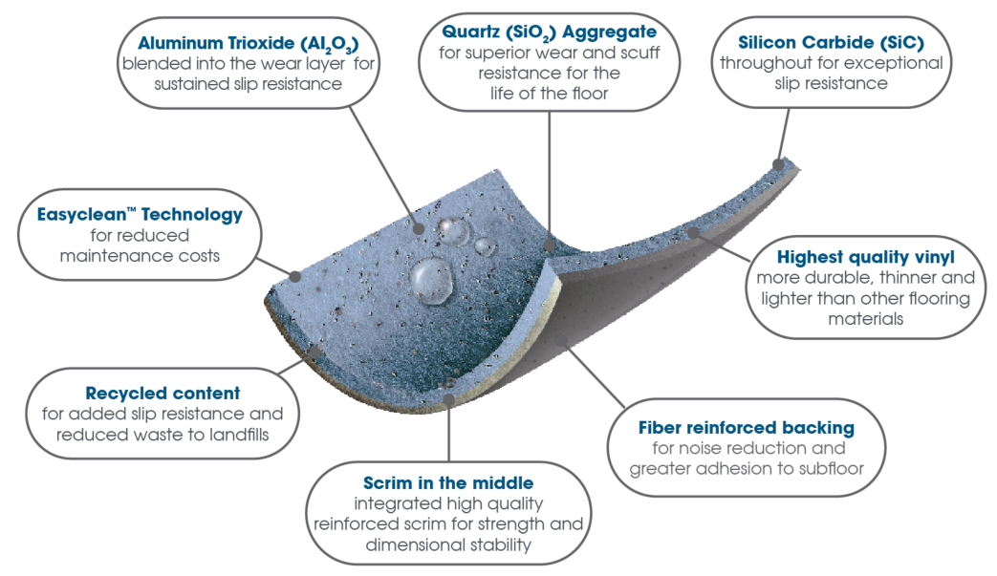
Why Altro?
Notes:
Altro floor coverings are a slip-resistant vinyl safety flooring. Altro’s unique patented construction of flexible, high-grade vinyl with slip-resistant aggregates embedded throughout the wear layer of the safety floor, ensures a durable surface that remains slip-resistant for the life of the floor. (Aluminum Trioxide – source of Altro’s name – and Silicon Carbide blended into the wear layer for exceptional sustained slip resistance, and Quartz for superior wear and scuff resistance)
Pound for pound, vinyl is more durable than many other flooring materials. This allows vinyl flooring to be thinner and lighter while still offering impressive durability. Combined with its natural imperviousness to water, vinyl makes an ideal flooring material especially for transit buses where passengers may track in snow or rain onto the bus.
Altro flooring incorporates aggregates of aluminum oxide, silicon carbide, and colored quartz. These minerals represent some of the hardest materials on Earth and ensure a true slip-resistant, durable surface that will last for the life of the floor. This superior level of durability is why we can offer warranties of up to 15 years.

Slide 10
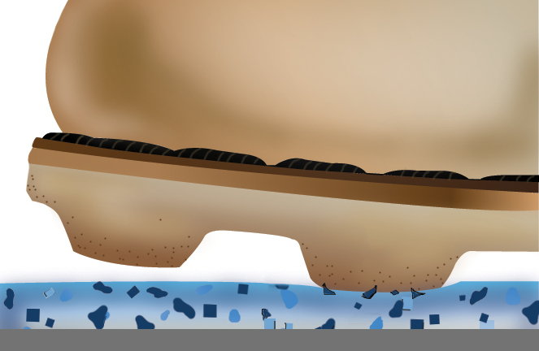
How it works
Downward pressure causes aggregates in flooring to push up creating friction against shoe sole.
Aggregates blended throughout wear layer ensure sustained slip resistance for life of the vehicle & up to a 15 year warranty
Works in both Wet and Dry conditions
Notes:
(CLICK) Downward pressure causes aggregates in flooring to push (CLICK) up creating friction against shoe sole.
Aggregates blended throughout wear (CLICK) layer ensure sustained slip resistance for life of the vehicle & up to a 15 year warranty

Slide 11
Why gamble with passenger safety

Slide 12
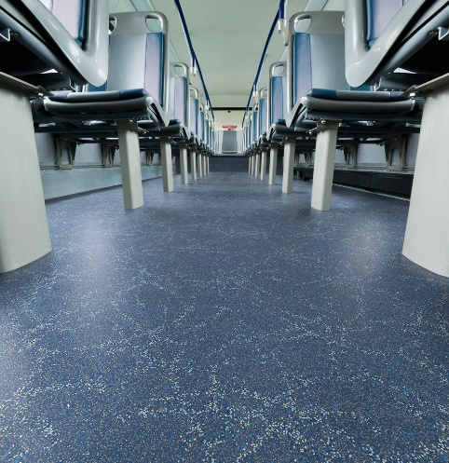
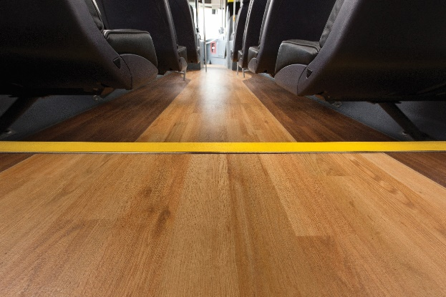
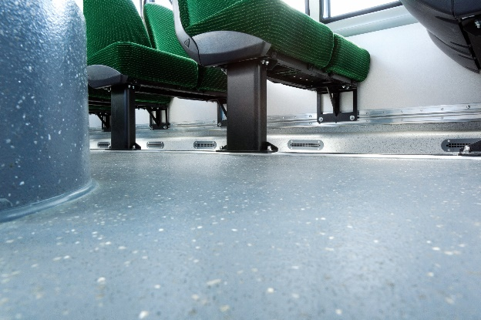
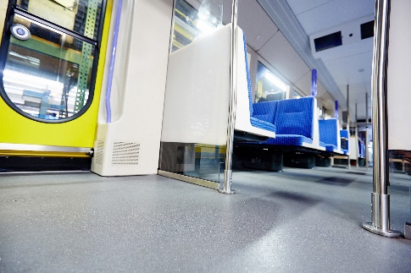
Product Range
Meta
HD+
Chroma
Wood
HD+
Figura
HD+
Meta, Chroma, & Figura now available in
HD+
Tungsten

Slide 13
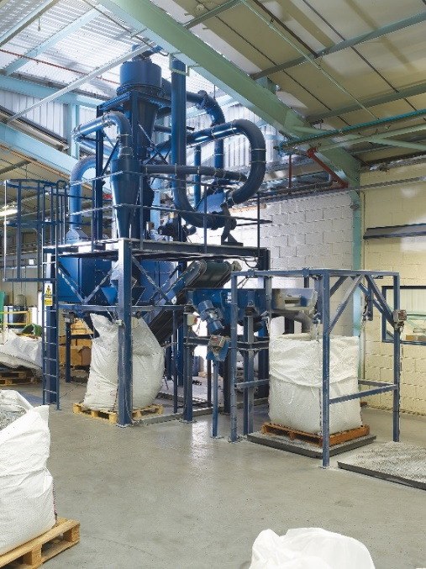
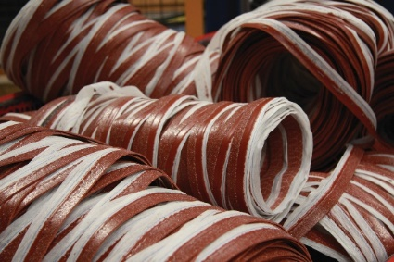
Benefits for using Altro products
The Altro Advantage
New formulation is 20% lighter
Altro Easy Clean – maximum protection against stains & dirt retention, facilitates easy maintenance
…and contains recycled content & bio based ingredients
Quality ingredients = Quality flooring
Available in 3 thicknesses 1.8, 2.2, and 2.7mm floors (the only lightweight heavy duty bus floor in the industry)
10 - 15 year warranty
HD+
60 colors
Kits, Logos, Signage, & Self-adhesive floors – save time & money, increase productivity, & decrease waste
4 North American warehouses
World Class Support – free expert advice and instruction from highly skilled service team before and after the sale

Slide 14
Before you make a final decision on your next flooring purchase:
Select a product designed and proven to meet the most extreme service demands
Ensure the product exceeds the life of the vehicle
Choose a partner that provides an unparalleled level of service
Consider a company that safeguards our environment
Select products that are easy to clean and maintain for the life of the vehicle
Choose a safety floor with slip resistance that is sustainable for the life of the floor
ASK FOR ALTRO BY NAME
YOUR FLEET DESERVES THE BEST

Slide 15
Thank You
800-382-0333

